Slide 1






Transforming YOUR APPLICATION WITH
Brian Ritchie
CTO, XeoHealth
@brian_ritchie
brian.ritchie@gmail.com
http://www.dotnetpowered.com
2018

Slide 2

Brian Ritchie
CTO for XeoHealth Corporation
22 years of technology experience developing software and managing technology teams in various industries.
Author of RavenDB High Performance published by PACKT in 2013.
Pursuing a Masters in Computer Science from Georgia Tech.
@brian_ritchie
brian.ritchie@gmail.com
http://www.dotnetpowered.com

Slide 3
WELCOME
INTRODUCTION TO ELASTIC SEARCH BRING YOUR DATA SECURITY CONSIDERATIONS PUTTING IT ALL TOGETHER

Slide 4
Let’s get started With the story of your application…

Slide 5
It was amazing… It even had the new application smell.

Slide 6
But then came the users, the data, and the New requirements….

Slide 7
Now your application is leaving you stranded on the side of the road…

Slide 8


So, Why is your application melting?
Too Many Reads, Too Many Writes = Contention

Slide 9
Is this the only future for your application?

Slide 10
No WAY! It’s time to pimp your ride!

Slide 11
INTRODUCING

Slide 12
INTRODUCING
Elasticsearch is a search engine based on Lucene. It provides a lightening fast, distributed, multitenant-capable full-text search engine with a HTTP RESTful interface.
Elasticsearch is released as open source under the terms of the Apache License. It can be deployed locally or hosted in the cloud.

Slide 13
INTRODUCING
Well known for being part of the
used to analyze log data generated by your application
Stack
Note: this was rebranded
The Elastic Stack

Slide 14


WHY
FOR YOUR APPLICATION
Extremely Fast. Optimized for search. Flexible Schema.
Document Centric
Index
Everything
FAST
Shard/
Partition
Distributed
Cluster

Slide 15
WHY
FOR YOUR APPLICATION
SCALABLE
“We can support clusters of massive scale. Well into the 100s of terabytes. One of our largest customers is currently at 750TB and should be in excess of 1PB by the end of the year. “ - Scalefastr
“Today there are 60+ Elasticsearch clusters and 2000+ nodes. The daily ingestion reaches 18 billion documents, and daily search requests reach 3.5 billion. ” - eBay

Slide 16
Your users on

Slide 17
That sounds awesome!! But, how does Elastic Search fit into my data infrastructure?
Bringing your data into

Slide 18
Utilizing a CQRS inspired pattern
Bringing your data into elastic search
Command/Query Responsibility Segregation (CQRS) is the idea that you can use a different model to update information than the model you use to read information
Transactional Data
Persistent View Model

Slide 19
OPTION 1: Add Elastic search into your database pipeline
Bringing your data into elastic search
Kafka
ActiveMQ
RabbitMQ
….
cluster

Slide 20
Bringing your data into elastic search
OPTION 2: Replicate database updates to Elastic Search
cluster
Kafka
ActiveMQ
RabbitMQ
….

Slide 21
Bringing your data into elastic search
OPTION 3: Batch your database updates on a schedule
cluster

Slide 22
Structuring your data for search
Data Modeling
Conceptually, indexes are like databases.
SQL => Databases => Tables => Columns/Rows
Elasticsearch => Indices => Types => Documents with Properties
Loans
Payments
Inventory

Slide 23
Defining indexes
Data Modeling:
Like databases, but more powerful. Queries can easily span indexes bringing data together as needed.
Use indexes for:
Security – use indexes to support
multi-tenant system
Partitioning – time or other
data
loan_hud
loan_fdic
log_20180501
log_20180502

Slide 24
Defining documents
Data Modeling:
Instead of decomposing data into separate entities:
Design documents based on what needs to be searched and displayed together:
{
"FirstName": "Jonathan",
"Address": "15 Wanamassa Point Road ",
"City": "Jacksonville",
"State": "FL",
"Children": [
{ "Name": "Michael", "Age": 10 },
{ "Name": "Jennifer", "Age": 8 },
{ "Name": "Samantha", "Age": 5 },
{ "Name": "Elena", "Age": 2 }
]
}

Slide 25
Teach Elastic Search about specific types
Data Modeling:
PUT _template/file_name_mapping
{ "template": ”loan_*", "settings": { "number_of_shards": 5 }, "mappings": { "_default_": { "dynamic_templates": [ { "filename_string_not_analyzed": { "match": "edi_filename", "mapping": { "index": "not_analyzed", "type": "string” } } } ] } } }

Slide 26
Giving the right users access to the right data
Security considerations
cluster
Elastic Stack
Security
Search Guard
Custom .NET Core / Java / etc.

Slide 27
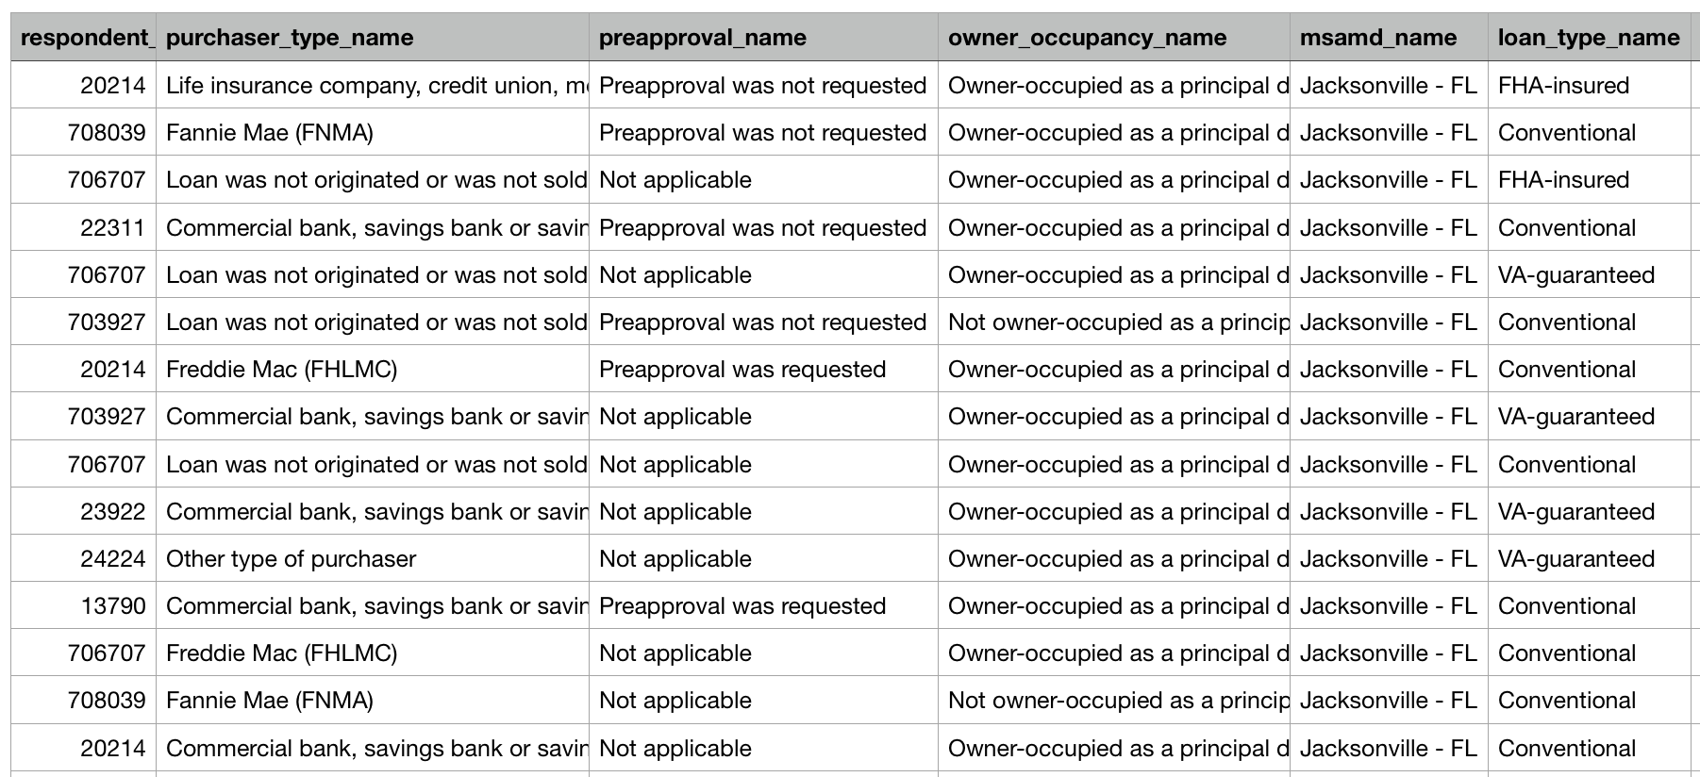
Searching CFPB loan records w/ Elastic Search
Putting it all together
The Home Mortgage Disclosure Act (HMDA) requires many financial institutions to maintain, report, and publicly disclose loan-level information about mortgages.

Slide 28

Loading CFPB loan records into Elastic Search
Putting it all together
var record = csv.GetRecord<dynamic>(); var loan = Loan.FromFileLoan(record);
var index_name = string.Format("loan_{0}",
loan.agency_abbr.ToLower()); var response = client.Index<Loan>(
new IndexRequest<Loan>(loan, index_name));
107 million loan records
{
"county": "Maricopa County",
"respondent_id": "0000451965",
"lien_status": "Not applicable",
"sequence_number": "0945293",
"applicant_income": 132000,
"preapproval": "Not applicable",
"applicant_race": "White",
"msamd": "Phoenix, Mesa, Scottsdale - AZ",
….

Slide 29
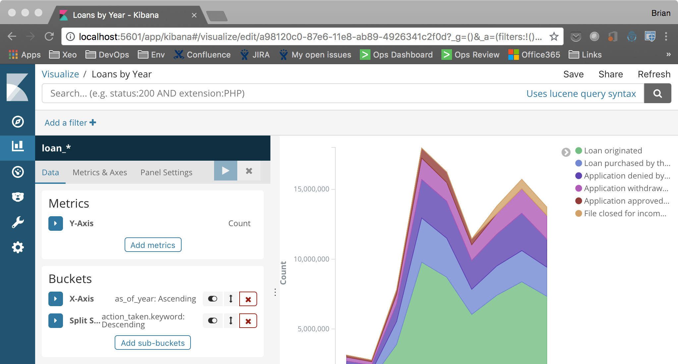
Using Kibana to search and visualize your data
Putting it all together

Slide 30
Using Elastic Search to optimize your user experience
Putting it all together
JWT
cluster
Single Page Application (SPA)
Angular / React / etc.
REST API
.NET Core / Java / etc.
Add security, logging, etc.
Query Request

Slide 31
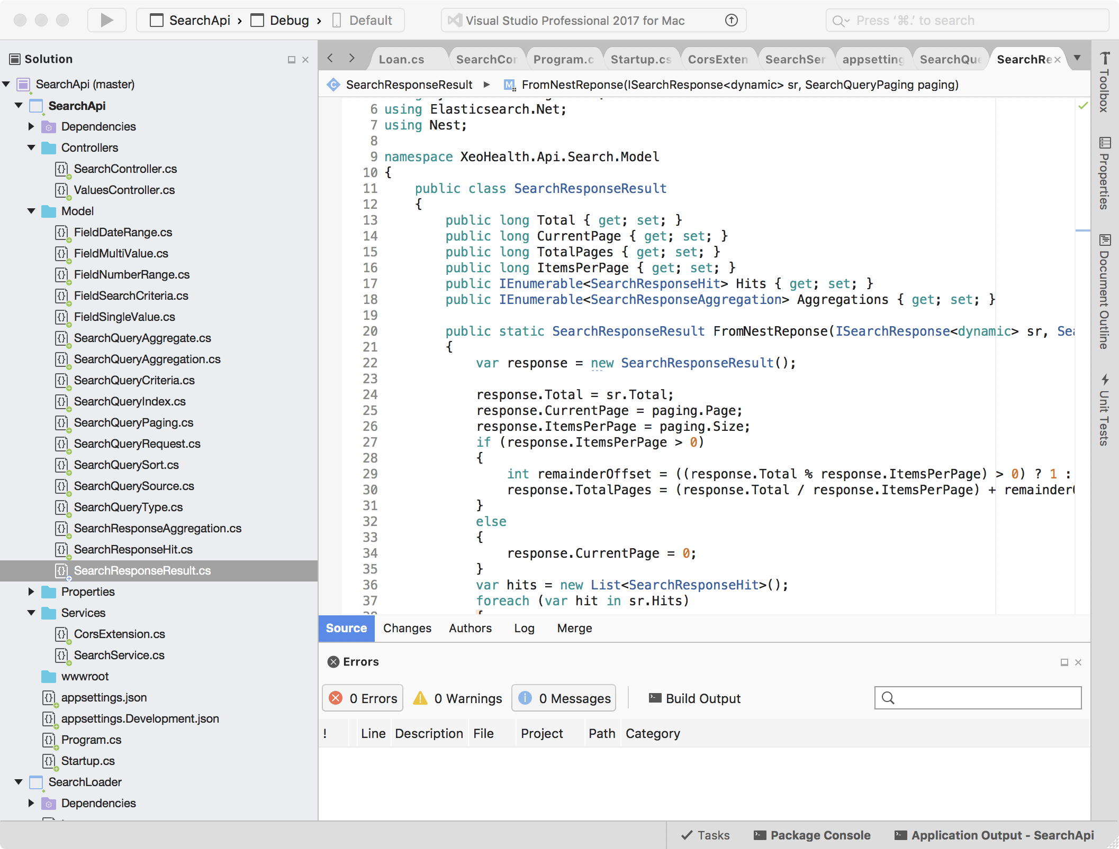
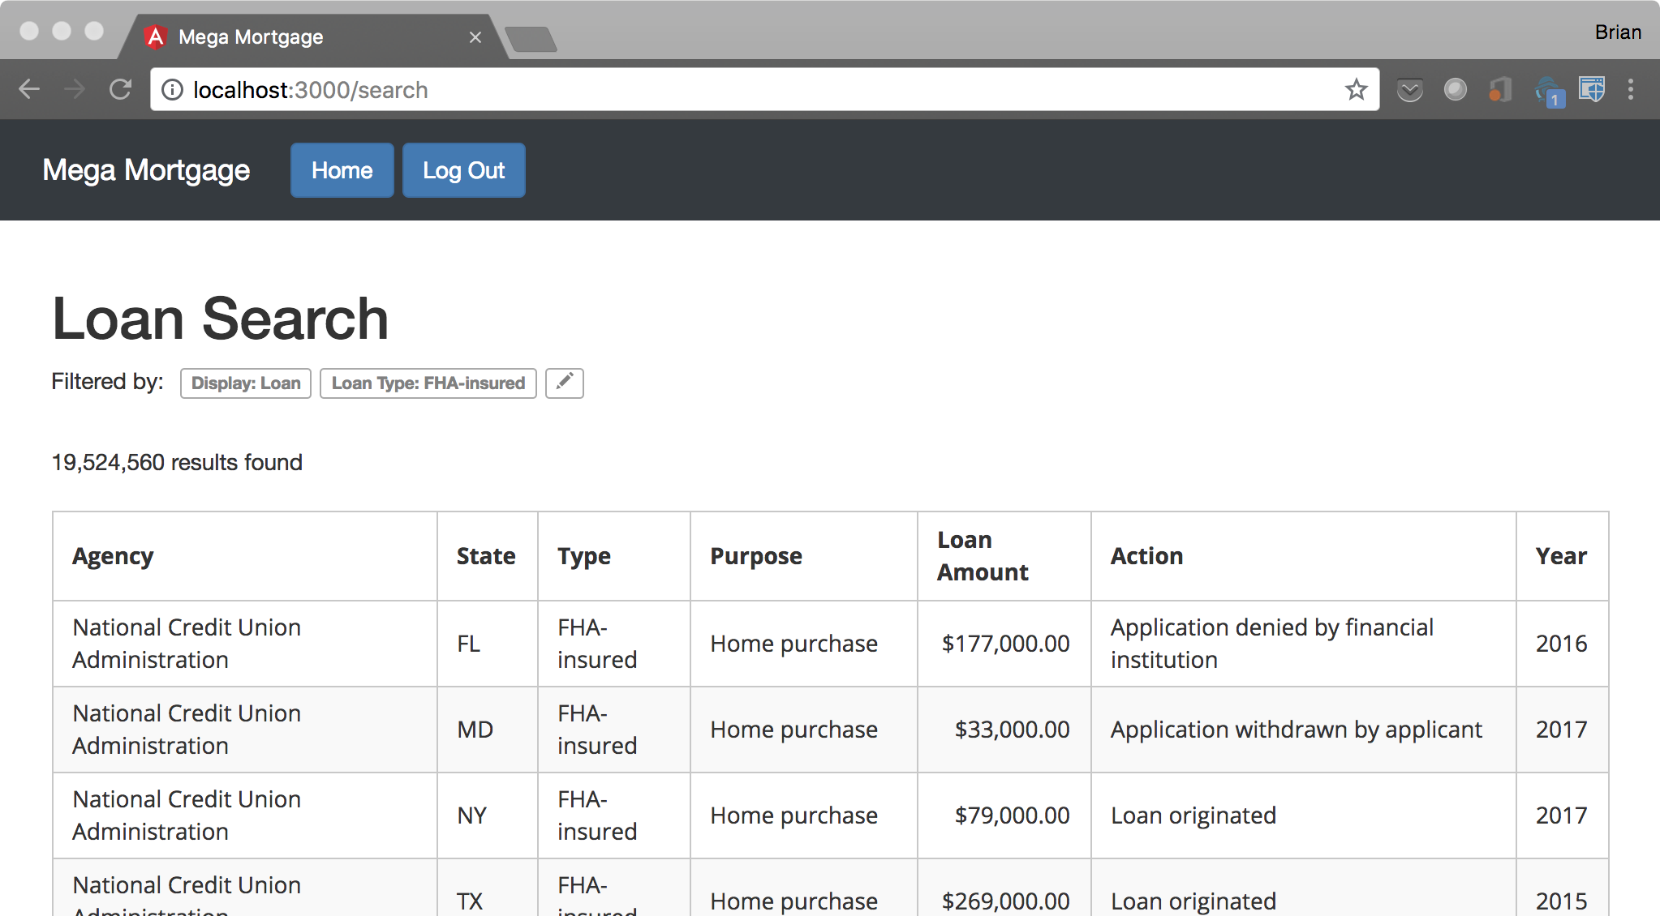
Custom application using Angular, PrimeNG, .NET Core, and Elastic Search
Putting it all together

Slide 32
Transforming YOUR APPLICATIONS WITH
QUESTIONS?
Brian Ritchie
CTO, XeoHealth
@brian_ritchie
brian.ritchie@gmail.com
http://www.dotnetpowered.com
2018

